Slide 1
Analysis of Non-Recursive Algorithms
Notes:
Lingering Questions from Last Class?

Slide 2
Two Phases of Analysis
Create a formula relating input size (n) to number of basic operations.
Formally prove that formula from step 1 belongs to a particular asymptotic class, Θ(n).

Slide 3
Non-Recursive Algorithms

Slide 4
Applying to Non-Recursive Alg.
Consider following algorithm:
MaxElement(A[0…n-1])
maxval ← A[0]
for i ← 1 to n-1 do
if A[i] > maxval
maxval ← A[i]
return maxval
What is input size, n?

Slide 5
Applying to Non-Recursive Alg.
Consider following algorithm:
MaxElement(A[0…n-1])
maxval ← A[0]
for i ← 1 to n-1 do
if A[i] > maxval
maxval ← A[i]
return maxval
Which operation should be considered basic?

Slide 6
Applying to Non-Recursive Alg.
Consider following algorithm:
MaxElement(A[0…n-1])
maxval ← A[0]
for i ← 1 to n-1 do
if A[i] > maxval
maxval ← A[i]
return maxval
Do we need to measure best/worst/avg case?

Slide 7
Applying to Non-Recursive Alg.
Consider following algorithm:
MaxElement(A[0…n-1])
maxval ← A[0]
for i ← 1 to n-1 do
if A[i] > maxval
maxval ← A[i]
return maxval
How many times does the basic operation get executed, relative to input size? (Expressed as summation)

Slide 8
Applying to Non-Recursive Alg.
Consider following algorithm:
MaxElement(A[0…n-1])
maxval ← A[0]
for i ← 1 to n-1 do
if A[i] > maxval
maxval ← A[i]
return maxval
What is the order of growth of the summation?

Slide 9
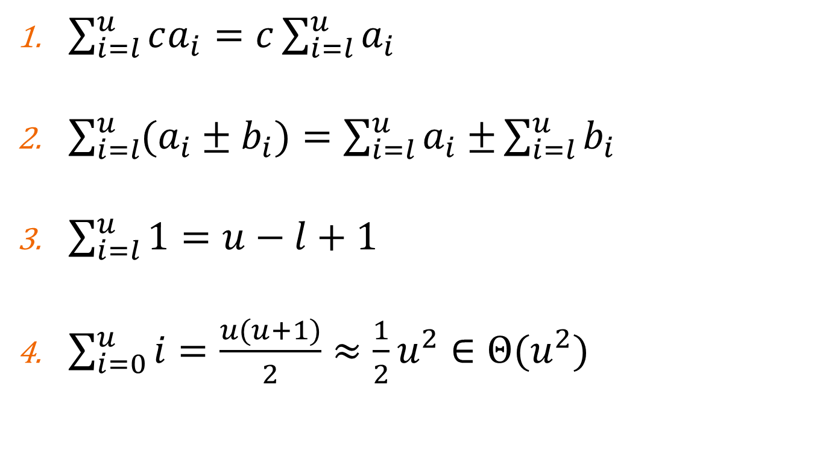
Useful Transformations
$\sum_{i=l}^{u}{ca_{i}=c\sum_{i=l}^{u}{a_{i}}}$
$\sum_{i=l}^{u}{(a_{i}±b_{i})=\sum_{i=l}^{u}{a_{i}±}}\sum_{i=l}^{u}{b_{i}}$
$\sum_{i=l}^{u}{1=u−l+1}$
$\sum_{i=0}^{u}{i=\frac{u(u+1)}{2}≈\frac{1}{2}u^{2}∈Θ(u^{2})}$

Slide 10
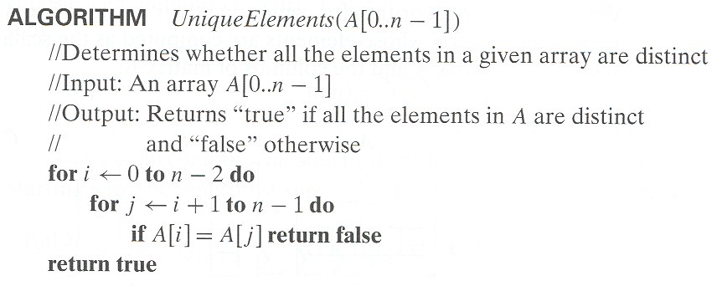
Another Example: Unique Elems

Slide 11
Lab 3

